Slide 1
Internet Protocol Version4
(IPv4)
TCP/IP Protocol Suite
Copyright © The McGraw-Hill Companies, Inc. Permission required for reproduction or display.

Slide 2
7-1 INTRODUCTION
The Internet Protocol (IP) is the transmission mechanism used by the TCP/IP protocols at the network layer.
TCP/IP Protocol Suite

Slide 3
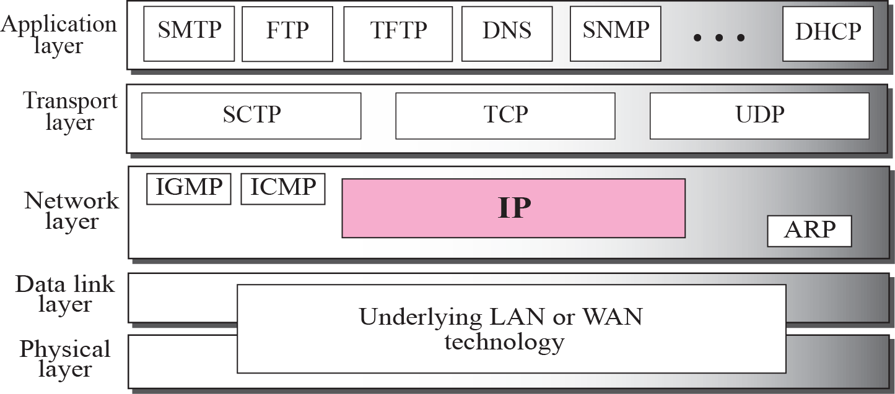
Figure 7.1 Position of IP in TCP/IP protocol suite
TCP/IP Protocol Suite

Slide 4
7-2 DATAGRAMS
Packets in the network (internet) layer are called datagrams. A datagram is a variable-length packet consisting of two parts: header and data. The header is 20 to 60 bytes in length and contains information essential to routing and delivery. It is customary in TCP/IP to show the header in 4-byte sections. A brief description of each field is in order.
TCP/IP Protocol Suite

Slide 5
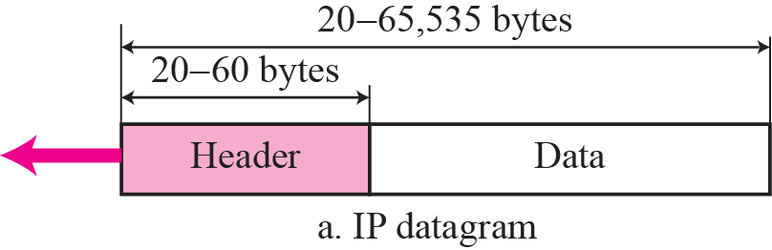
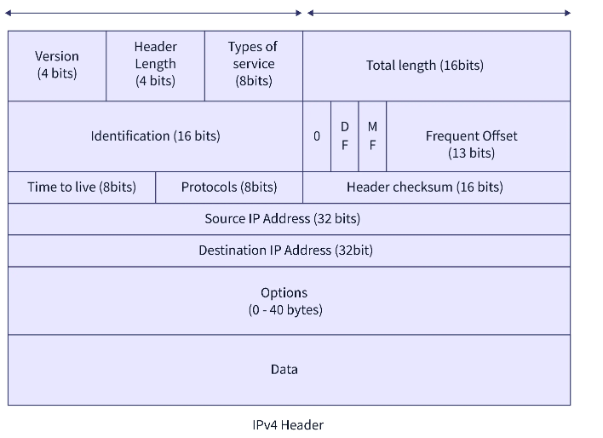
Figure 7.2 IP datagram
TCP/IP Protocol Suite

Slide 6
Version (VER)
It is a 4-bit field that defines the version of the IPv4 protocol, which is 4. Version-4 (IPv4) and version-6 (IPv6) of the IP protocol are the most widely used versions.
Header Length (HLEN)
It is a 4-bit field containing the IP header's length. This field helps in knowing from where the actual data begins. This field is needed because the header's length is variable (between 20 and 60 bytes).
Since it is a 4-bit field,[0, 15] is the range of decimal values that can be expressed. The IP header's first five rows are always used.
Therefore, an IP header's minimum length is (5 x 4 bytes). The sixth row, which represents the Options field, has a maximum size of 40 bytes. Therefore, an IP header's maximum length is 20+40=6020+40=60 bytes. We use a scaling factor of 4 to represent the header length [20, 60].
TCP/IP Protocol Suite

Slide 7
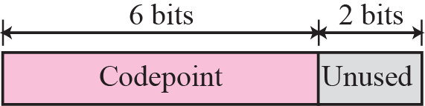
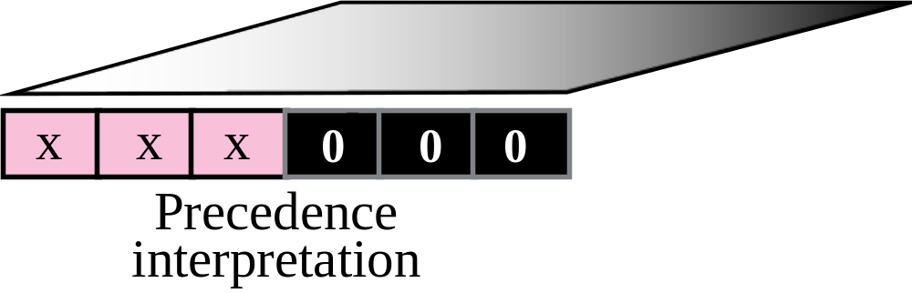
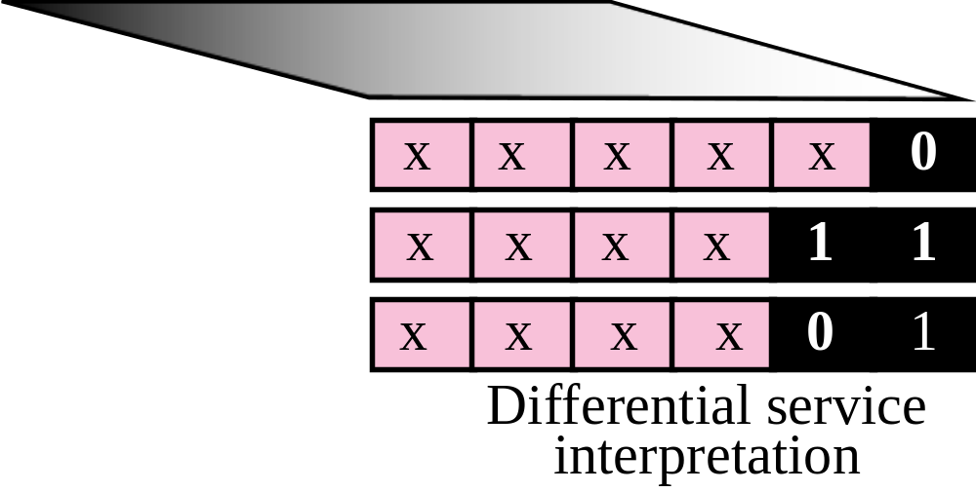
Figure 7.3 Service type
TCP/IP Protocol Suite

Slide 8
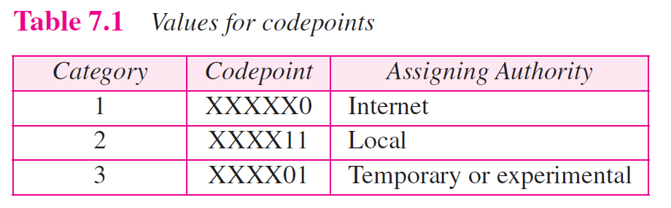
TCP/IP Protocol Suite

Slide 9
The total length field defines the total length of the datagram including the header.
It is a 16-bit field that contains the total length of the IP Packet (including the IP header and IP Payload).
Total length=Header length + Payload length
The total length has a minimum value of 20 bytes (20 bytes header + 0 bytes data), and the maximum is 65,535 bytes.
TCP/IP Protocol Suite

Slide 10
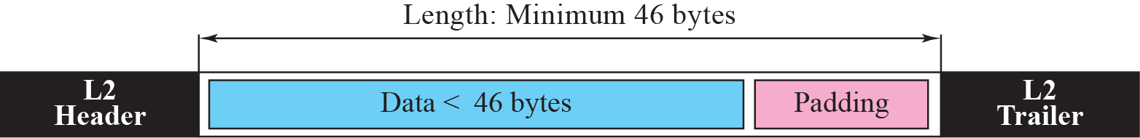
Figure 7.4 Encapsulation of a small datagram in an Ethernet frame
TCP/IP Protocol Suite

Slide 11
Identification
It is a 16-bit field used to identify the fragments of an original IP datagram.
If an IP packet is fragmented during the transmission, Each fragment contains the same identification number. It helps to identify the original IP packet they belong to
TCP/IP Protocol Suite

Slide 12
DF Bit
DF bit stands for Do Not Fragment bit. It is a 1-bit field, and its value may be 0 or 1. When it is set to 0, it allows intermediate devices to fragment the datagram if necessary. When it is set to 1, it instructs the intermediary devices to avoid IP datagram fragmentation at all costs.
MF Bit
MF bit stands for More Fragments bit. It is a 1-bit field, and its value may be 0 or 1. If it is set to 0, it indicates to the receiver that the current datagram is either the final fragment of the set or the only fragment. If it is set to 1, it indicates to the receiver that the current datagram is a fragment of some larger datagram.
Fragment Offset
It is a 13-bit field. It tells the exact position of the fragmented datagram in the original unfragmented IP datagram
TCP/IP Protocol Suite

Slide 13
Time To Live (TTL)
TTL is an 8-bit field. It prevents the datagram from looping over the network by reducing the number of hops a packet can take before reaching its destination.
Protocol
It is an 8-bit field. It identifies to the network layer at the destination host which protocol this IP datagram belongs to, i.e., the next level Protocol. For example, the ICMP's protocol number is 1, while TCP's is 6 and UDP's is 17.
.
TCP/IP Protocol Suite

Slide 14
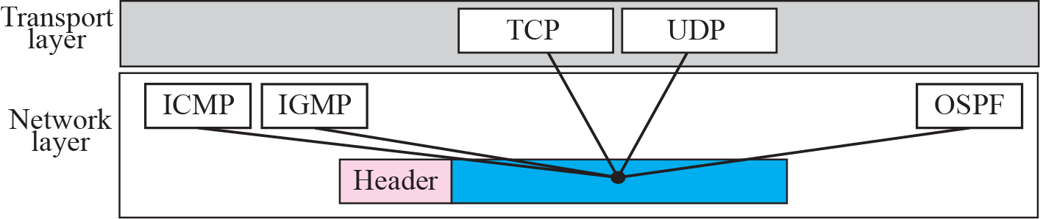
Figure 7.5 Multiplexing
TCP/IP Protocol Suite

Slide 15
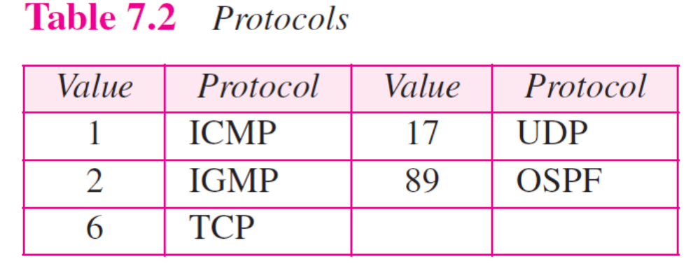
TCP/IP Protocol Suite

Slide 16
Header Checksum
It is a 16-bit field containing the entire header's checksum value. This checksum value is used for checking errors in the datagram header.
The header checksum is only calculated for the header, not for the data, since some fields, like TTL, etc., change at every router hop. Therefore every time calculating checksum of data will be a waste of resources.
Source IP Address
This is a 32-bit field and contains the IP address of the datagram's sender (or source).
Destination IP Address
This is a 32-bit field and contains the IP address of the datagram's receiver (or destination).
TCP/IP Protocol Suite

Slide 17
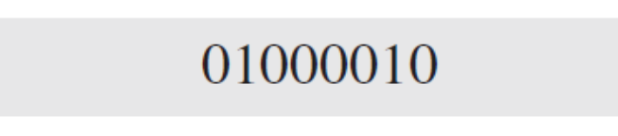
Example 7.1
An IP packet has arrived with the first 8 bits as shown:
The receiver discards the packet. Why?
Solution
There is an error in this packet. The 4 left-most bits (0100) show the version, which is correct. The next 4 bits (0010) show the wrong header length (2 × 4 = 8). The minimum number of bytes in the header must be 20. The packet has been corrupted in transmission.
TCP/IP Protocol Suite

Slide 18
Example 7.2
In an IP packet, the value of HLEN is 1000 in binary. How many bytes of options are being carried by this packet?
Solution
The HLEN value is 8, which means the total number of bytes in the header is 8 × 4 or 32 bytes. The first 20 bytes are the base header, the next 12 bytes are the options.
TCP/IP Protocol Suite

Slide 19
Example 7.3
In an IP packet, the value of HLEN is 5₁₆ and the value of the total length field is 0028₁₆. How many bytes of data are being carried by this packet?
Solution
The HLEN value is 5, which means the total number of bytes in the header is 5 × 4 or 20 bytes (no options). The total length is 40 bytes, which means the packet is carrying 20 bytes of data (40 − 20).
TCP/IP Protocol Suite

Slide 20
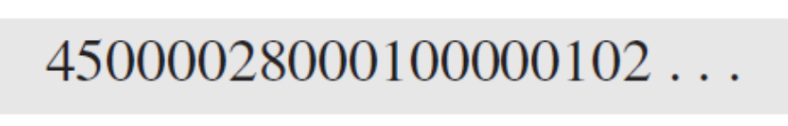
Example 7.4
An IP packet has arrived with the first few hexadecimal digits as shown below:
How many hops can this packet travel before being dropped? The data belong to what upper layer protocol?
Solution
To find the time-to-live field, we skip 8 bytes (16 hexadecimal digits). The time-to-live field is the ninth byte, which is 01. This means the packet can travel only one hop. The protocol field is the next byte (02), which means that the upper layer protocol is IGMP (see Table 7.2)
TCP/IP Protocol Suite

Slide 21
7-3 FRAGMENTATION
A datagram can travel through different networks. Each router decapsulates the IP datagram from the frame it receives, processes it, and then encapsulates it in another frame. The format and size of the received frame depend on the protocol used by the physical network through which the frame has just traveled. The format and size of the sent frame depend on the protocol used by the physical network through which the frame is going to travel.
TCP/IP Protocol Suite

Slide 22

Figure 7.6 MTU
TCP/IP Protocol Suite

Slide 23

Note
Only data in a datagram is fragmented.
TCP/IP Protocol Suite

Slide 24

Figure 7.7 Flags field
TCP/IP Protocol Suite

Slide 25
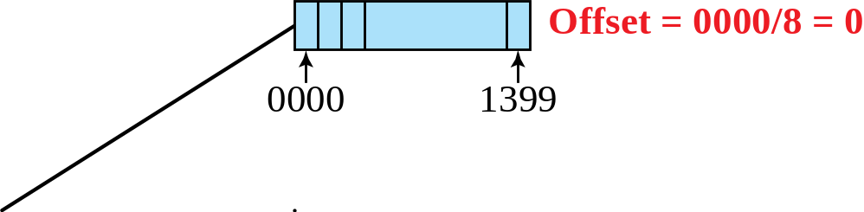
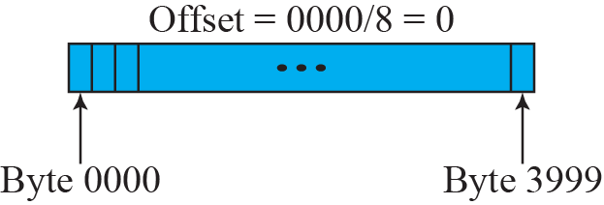
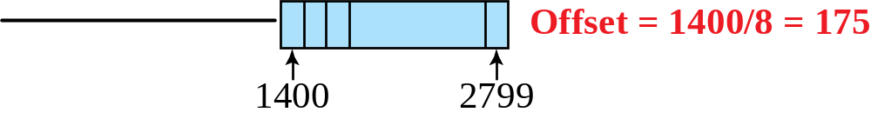
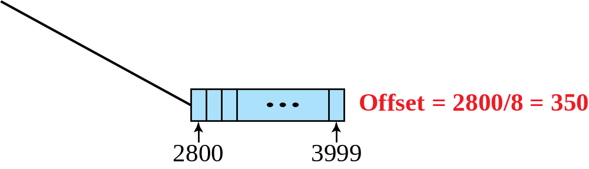
Figure 7.8 Fragmentation example
TCP/IP Protocol Suite

Slide 26
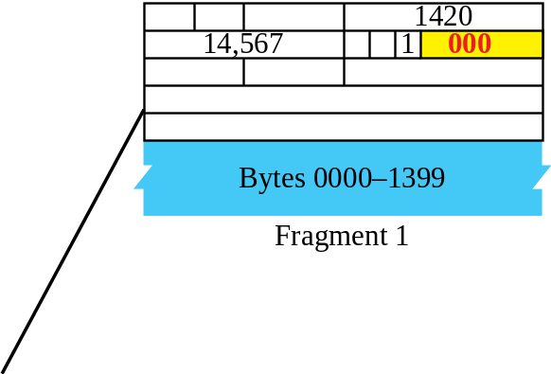
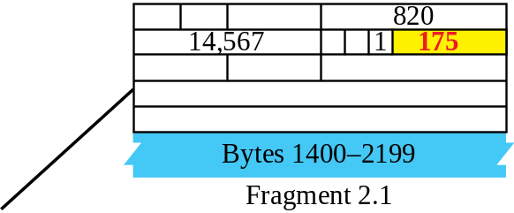
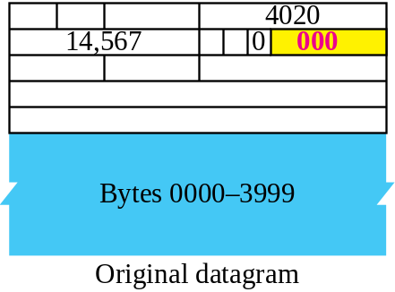
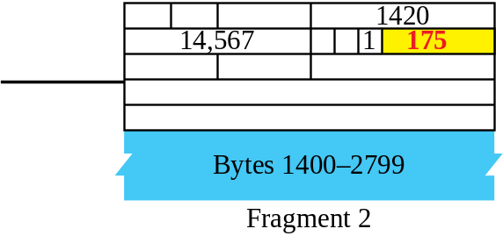
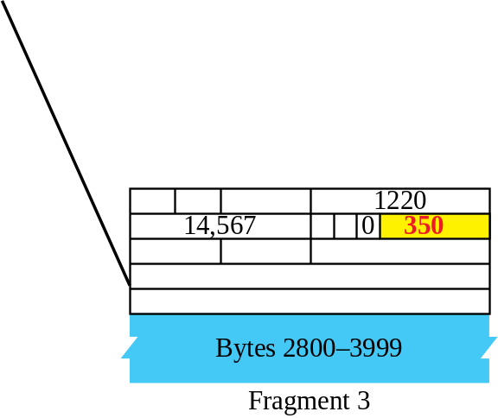
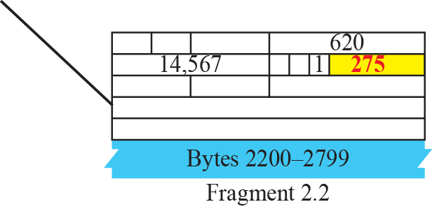
Figure 7.9 Detailed fragmentation example
TCP/IP Protocol Suite

Slide 27
Example 7.5
A packet has arrived with an M bit value of 0. Is this the first fragment, the last fragment, or a middle fragment? Do we know if the packet was fragmented?
Solution
If the M bit is 0, it means that there are no more fragments; the fragment is the last one. However, we cannot say if the original packet was fragmented or not. A nonfragmented packet is considered the last fragment.
TCP/IP Protocol Suite

Slide 28
Example 7.6
A packet has arrived with an M bit value of 1. Is this the first fragment, the last fragment, or a middle fragment? Do we know if the packet was fragmented?
Solution
If the M bit is 1, it means that there is at least one more fragment. This fragment can be the first one or a middle one, but not the last one. We don’t know if it is the first one or a middle one; we need more information (the value of the fragmentation offset). See also the next example.
TCP/IP Protocol Suite

Slide 29
Example 7.7
A packet has arrived with an M bit value of 1 and a fragmentation offset value of zero. Is this the first fragment, the last fragment, or a middle fragment?
Solution
Because the M bit is 1, it is either the first fragment or a middle one. Because the offset value is 0, it is the first fragment.
TCP/IP Protocol Suite

Slide 30
Example 7.8
A packet has arrived in which the offset value is 100. What is the number of the first byte? Do we know the number of the last byte?
Solution
To find the number of the first byte, we multiply the offset value by 8. This means that the first byte number is 800. We cannot determine the number of the last byte unless we know the length of the data.
TCP/IP Protocol Suite

